Slide 1




Hoo Hacks 2019
Theodore Rose | Raahish Kalaria
Arvind Anand | William Peterson

Slide 2

Started by John Sammon (story)
Historically has been a DOD contracting and restaurant hardware business
DOD contracting:
Restaurant hardware:
In 2014, Par acquired the restaurant POS SaaS platform, Brink
Brink has grown from 400 to 7,000 (est.) users with little investment
Stock is owned by a concentrated group of shareholders
Sammon & co.
ADW, Voss, & co.
Ticker:
“PAR”
Stock Price:
$17.06
Market Cap:
$278,916,000
‘98-’14 IRR:
.99%

Slide 3


Slide 4


Slide 5

Market Perception
Par’s current market valuation implies no acceleration in Brink user growth and increased monetization of the platform
Old Par Valuation |  |  | Brink Liquidation Valuation
Government business | $ 156,305 |  | Installment base | 7,000
Hardware/service | $ 26,406 |  | No-growth ARPU | $ 150.00
Working capital | $ 73,023 |  | Revenue | $ 14,040
Real estate | $ 25,883 |  | Gross magins | 80%
Total asset value | $ 281,616 |  | Gross profit | $ 11,232
Total liabilities | $ 58,524 |  | Operating expenses | 20%
Liquidation value (ex. Brink) | $ 223,092 |  | EBIT | $ 8,424
 |  |  | Intall base decline rate | 6%
 |  |  | Assumed multiple | 4.5x
Brink Implied Future Expectations |  |  | Install base value | $ 37,908
Par enterprise value | $ 270,522
Implied Brink value | $ 47,430
Value ascribed to future Brink users | $ 9,522
Base case 2020 Brink liquidation value | $ 97,477.71

Slide 6
Investment Thesis Points
Continued acceleration of Brink user growth
1
Brink has proven itself to have a best-in-class product for its vertical
Current level of ROIC on marketing and support is sustainable
Increased monetization of Brink
2
Restaurant POS and back office operations are particularly variable
All of Brink’s competitors have nodes which they upsell aggressively
Imminent visibility catalysts
3
Increased specificity in reporting across segments should reveal the value of Par’s assets
A third party capital raise could occur at a significantly higher valuation

Slide 7
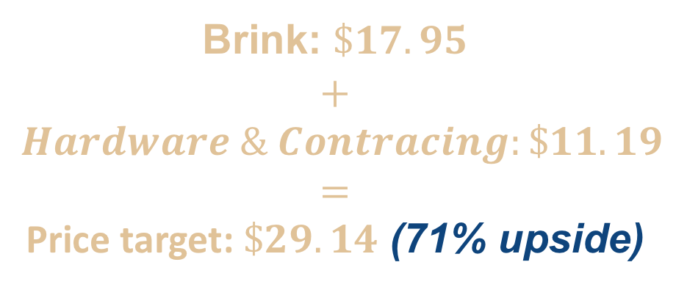
Valuation
Brink User Build
Hardware & Contracting Value
Government Contracting Valuation
2018 EBIT | 11,115,000
Multiple | Implied EV
12x | $ 133,380,000
14x | $ 156,304,688
16x | $ 178,173,450
Government Hadware Valuation
2018 EBIT | 77,663,390
Multiple | Implied EV
0.28x | $ 21,745,749
0.34x | $ 26,405,553
0.86x | $ 66,984,674
Brink: $\$17.95$
$$+$$
$$Hardware \& Contracing:\$11.19$$
$$=$$
Price target: $\$29.14$ (71% upside)
Brink Valuation
Par Valuation
2019 Sales | 22,543,500
Multiple | Implied EV
10x | $ 225,435,000
11x | $ 247,978,500
12x | $ 270,522,000
13x | $ 293,065,500
14x | $ 315,609,000
15x | $ 338,152,500
16x | $ 360,696,000
Par 2020 Valuation
2020 Sales | 41,157,900
Multiple | Implied EV | CAGR
7x | $ 288,105,300 | 25%
9x | $ 370,421,100 | 33%
10x | $ 411,579,000 | 37%
11x | $ 452,736,900 | 41%
12x | $ 493,894,800 | 44%
13x | $ 535,052,700 | 48%
15x | $ 617,368,500 | 54%

Slide 8
Investment Thesis Points
Thesis Point 1: Brink user growth will accelerate
Brink has proven itself to have a best-in-class product for its vertical
No other software has as many 500+ location clients
Brink has yet to lose a single client
Current level of ROIC on marketing and support is sustainable
Par’s strong hardware relationships are exploitable
Bottleneck on sales appears to be the size of the technician base
Total market penetration is safely under 10%
Thesis Point 2: Brink will be monetized at a higher rate
Restaurant POS and back office operations are particularly variable
All of Brink’s competitors have nodes which they upsell aggressively
Par Pay is currently being rolled out
Clear potential for inventory management, online ordering, loyalty program, and staffing nodes
Thesis Point 3: Action will taken to prove Brink’s value
Increased specificity in reporting across segments should reveal the value of Par’s assets
A third party capital raise could occur at a significantly higher valuation

